Slide 1


SAP OData Training
Day - 5.

Slide 2


Agenda Day - 5
Sales Order , Sales Order Item – Get Method’s
Association between Sales Order and Order Items
Defining Deep Entity
Break
Implementation of Deep Entity
Understand Payload
Testing in Postman Tool
What is Function Import
How to Use Function Import
Implementation of Function Import
Trainer: Anubhav Oberoy & Shubham Singh

Slide 3
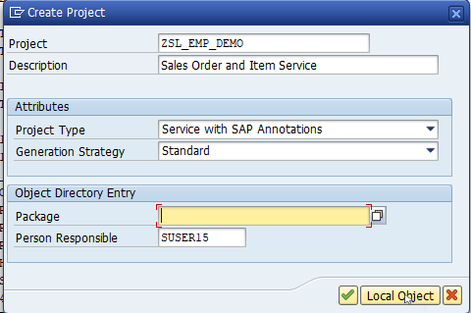
Build OData Service for Sales Order Header And Sales Order Item Data
Introduction
01
Software Innovation
02
Trainer: Anubhav Oberoy & Shubham Singh

Slide 4
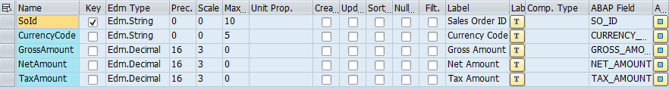
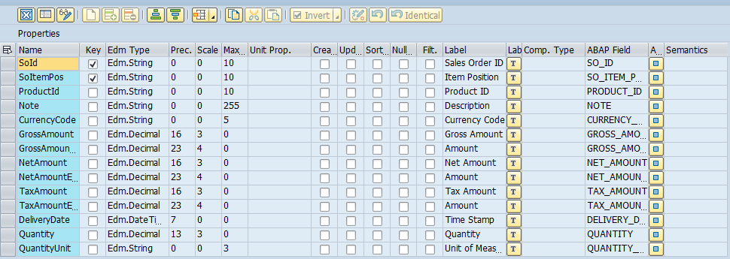
Building Entity Type
Sales Order Entity Type Properties
Sales Order Items Entity Type Properties
01
Software Innovation
02
Trainer: Anubhav Oberoy & Shubham Singh

Slide 5
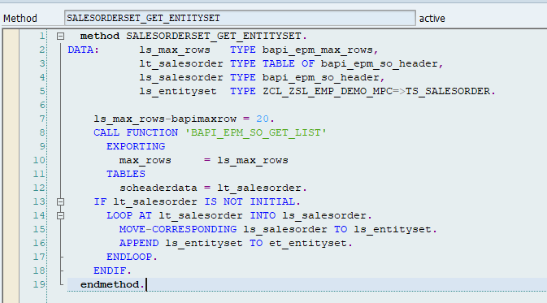
Building Get EntitySet for Sales Order
Go to DPC extension and redefine the method for SalesOrderSet Get EntitySet
Introduction
01
Software Innovation
02
Hardware Innovation
Note: Click on the image to get Complete code.
Trainer: Anubhav Oberoy & Shubham Singh

Slide 6
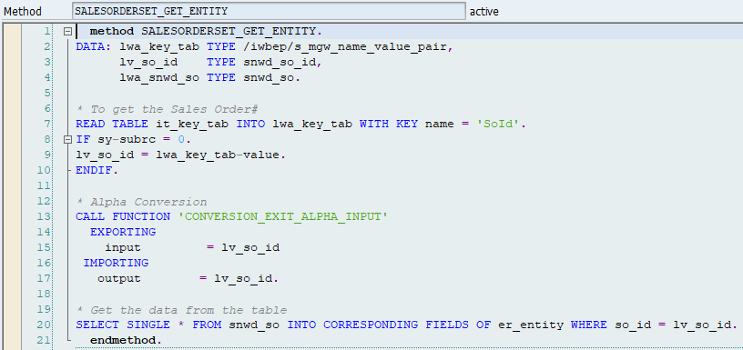
Building Get Entity(Single Record) Method
Go to DPC extension and redefine the method for SalesOrderSet Get Entity
Introduction
01
Software Innovation
02
Hardware Innovation
Note: Click on the image to get Complete code.
Trainer: Anubhav Oberoy & Shubham Singh

Slide 7
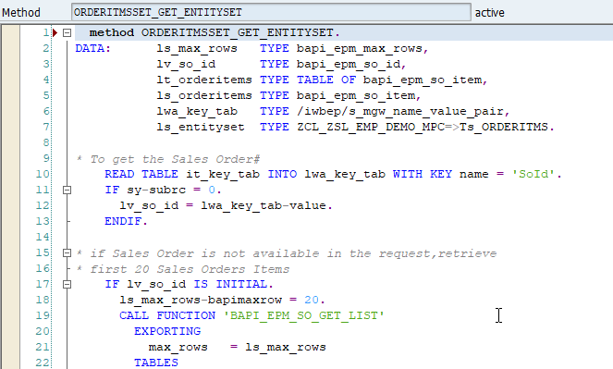
Building Get Entity Set Method for OrderItems
Go to DPC extension and redefine the method for OrderItmsSet Get EntitySet
Introduction
01
Software Innovation
02
Note: Click on the image to get Complete code.
Trainer: Anubhav Oberoy & Shubham Singh

Slide 8
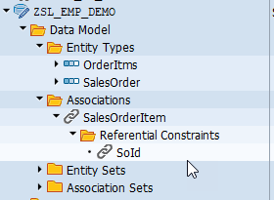
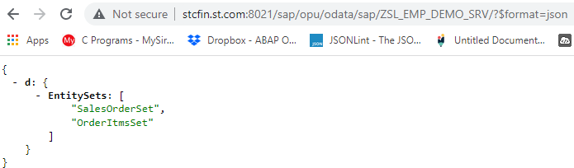
Association Between Sales Order and Sales Order Item
Introduction
01
02
Note: Click on the image for get Service URL.
Trainer: Anubhav Oberoy & Shubham Singh

Slide 9

Defining Deep Insert
Deep insert is used to POST the nested structure of feed/collections to the back-end system. It is opposite to the $expand in which we GET the nested structure of collections. By implementing this you can reduce the no. of OData calls made to the SAP NetWeaver Gateway server.
SAP Gateway Deep Inset allows to store hierarchical data like in our case Sales Order that has both header and item data (one can not exist without another). ... Deep Inset is an opposite to $expand URI option.
Introduction
01
Hardware Innovation
Trainer: Anubhav Oberoy & Shubham Singh

Slide 10
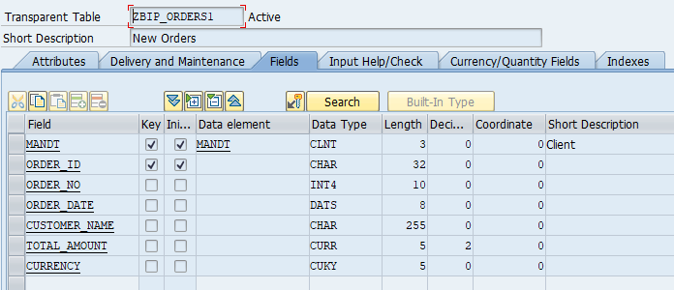
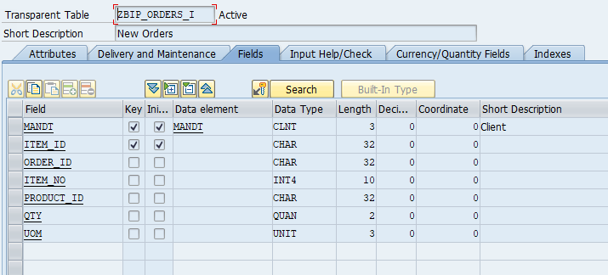
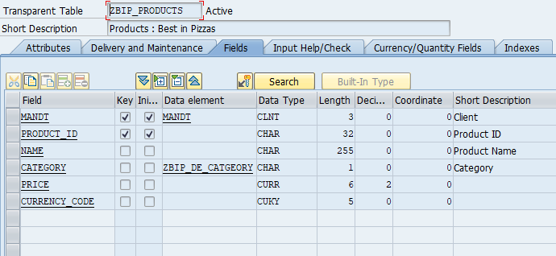
Building Deep Insert Scenario
Create Custom Table for Orders, Order Items and Products Data
1
2
Introduction
3
Hardware Innovation
Trainer: Anubhav Oberoy & Shubham Singh

Slide 11
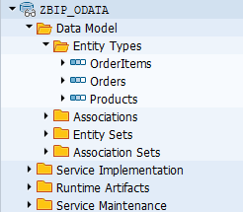
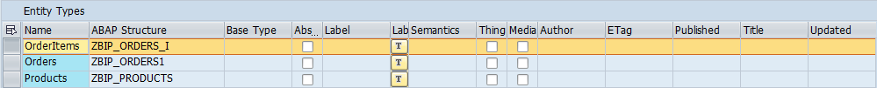
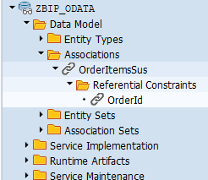
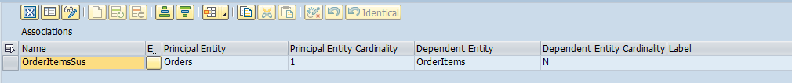
Create OData Service
Create an OData Service With 3 Entity Types and One Association Between Orders And Order Item( 1..N)
02
Association Between Orders and Order Items
Trainer: Anubhav Oberoy & Shubham Singh

Slide 12
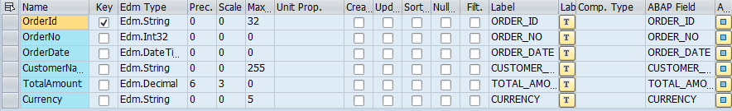
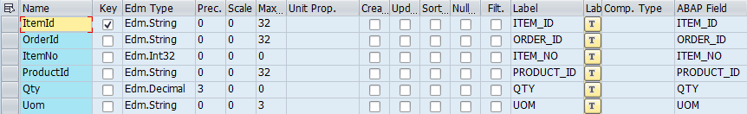
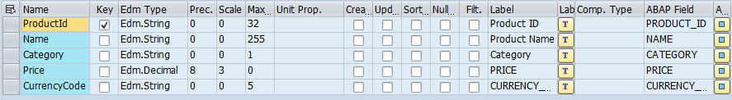
Entity Type
1. Orders Properties
2. Order Items Properties
3. Products Properties
02
Trainer: Anubhav Oberoy & Shubham Singh

Slide 13

Break

Slide 14
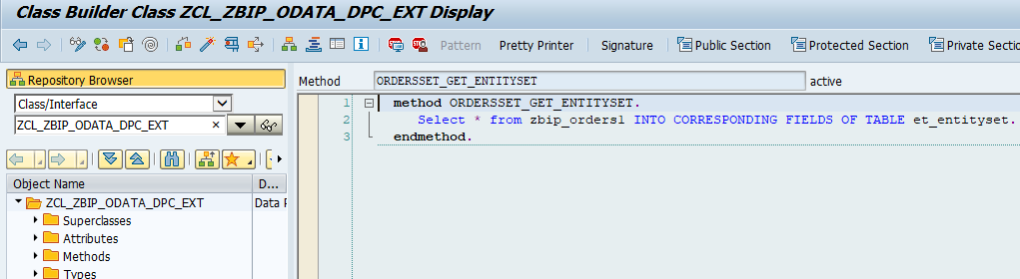
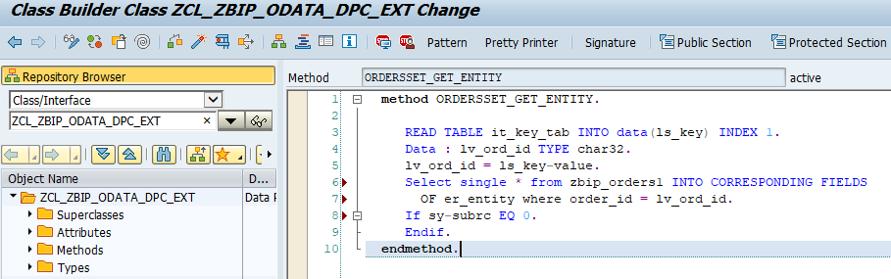
Building Get Entity Set for Orders
Go to DPC extension and redefine the method for Orders Get Entity Set
Introduction
Building Get Entity(Single Record) for Orders
Go to DPC extension and redefine the method for Orders Get Entity
01
02
Hardware Innovation
Note: Click on the image to get Complete code.
Trainer: Anubhav Oberoy & Shubham Singh

Slide 15
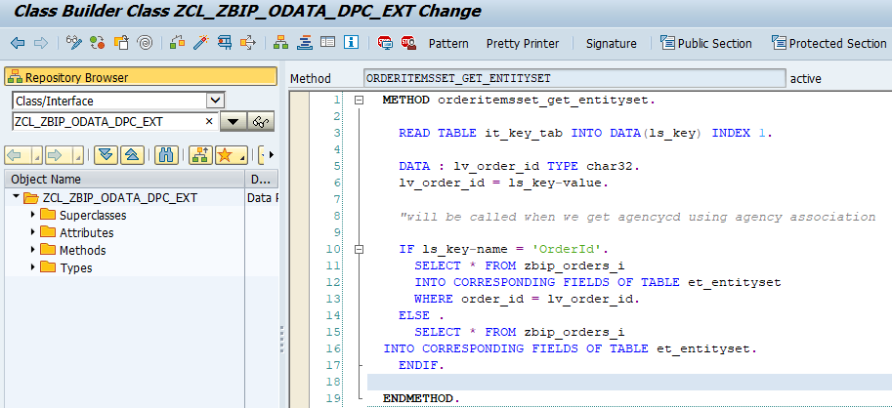
Building Get Entity Set for OrderItems
Go to DPC extension and redefine the method for OrderItems Get Entity Set
Introduction
01
Software Innovation
02
Hardware Innovation
Note: Click on the image to get Complete code.
Trainer: Anubhav Oberoy & Shubham Singh

Slide 16
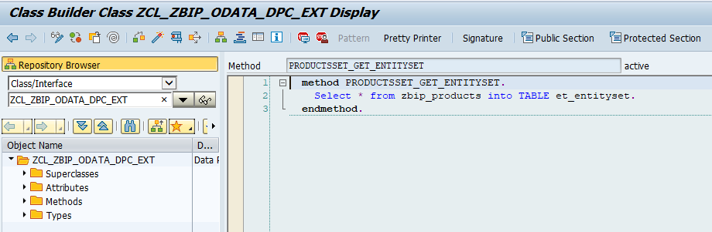
Building Get Entity Set for Products
Go to DPC extension and redefine the method for OrderItems Get Entity Set
Introduction
01
Software Innovation
02
Hardware Innovation
Note: Click on the image to get Complete code.
Trainer: Anubhav Oberoy & Shubham Singh

Slide 17
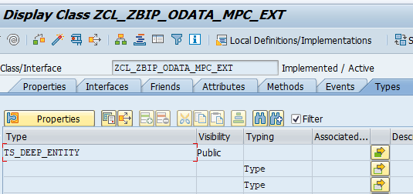
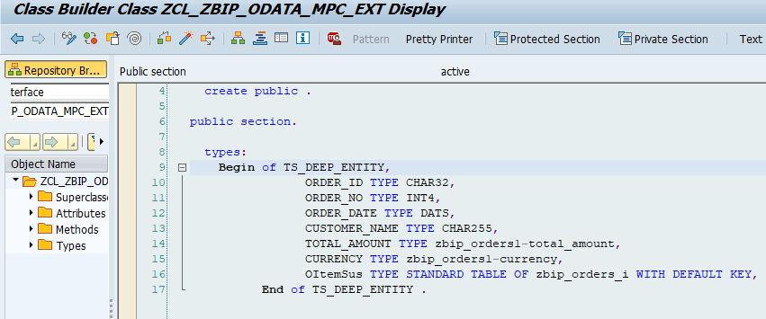
Create Type in MPC_EXT Class
Go to MPC extension and Create Types for Deep Entity “TS_DEEP_ENTITY”
Create Structure of Deep Entity their.
01
02
Note: Click on the image to get Complete code.
Trainer: Anubhav Oberoy & Shubham Singh

Slide 18
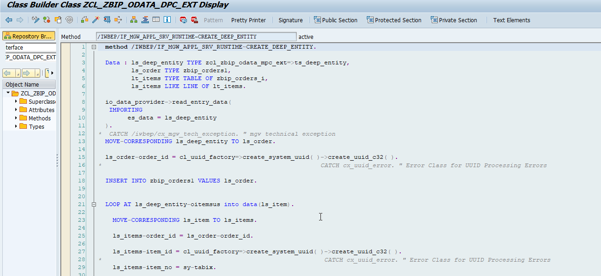
Building Code for Deep Entity
Go to DPC Extension and search for the method--/IWBEP/IF_MGW_APPL_SRV_RUNTIME~CREATE_DEEP_ENTITY and redefine the class method.
Introduction
01
02
Note: Click on the image to get Complete code.
Trainer: Anubhav Oberoy & Shubham Singh

Slide 19
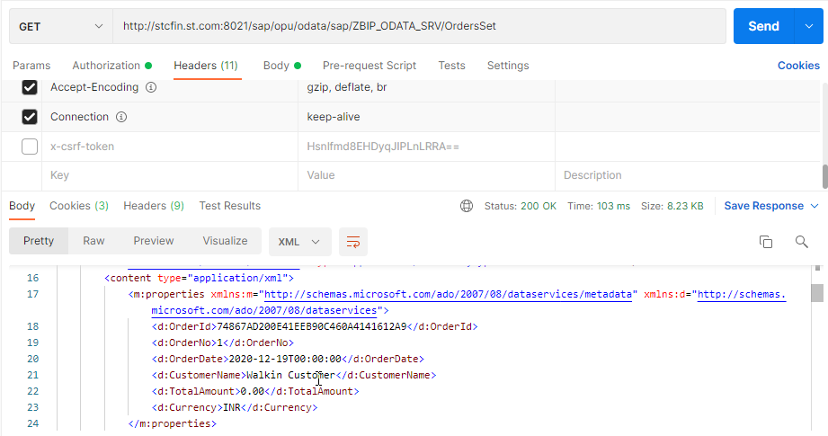
Test OData Service in Postman
Service URL
Introduction
01
Software Innovation
02
Trainer: Anubhav Oberoy & Shubham Singh

Slide 20
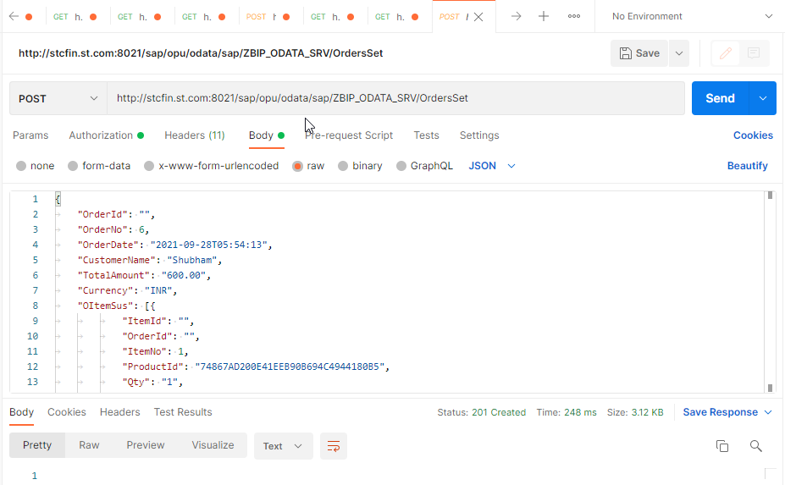
Preparing Payload for Deep Entity
{
"OrderId": "",
"OrderNo": 6,
"OrderDate": "2021-09-28T05:54:13",
"CustomerName": “Anubhav",
"TotalAmount": "600.00",
"Currency": "INR",
"OItemSus": [{
"ItemId": "",
"OrderId": "",
"ItemNo": 1,
"ProductId": "74867AD200E41EEB90B694C4944180B5",
"Qty": "1",
"Uom": "PC"
},
{
"ItemId": "",
"OrderId": "",
"ItemNo": 2,
"ProductId": "74867AD200E41EEB90B6968C5DA840B7",
"Qty": "1",
"Uom": "PC"
}
]
}
Introduction
01
Software Innovation
02
Trainer: Anubhav Oberoy & Shubham Singh

Slide 21
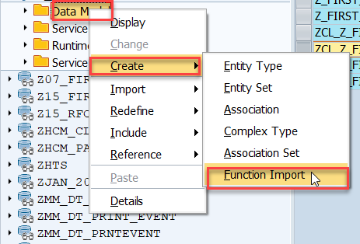
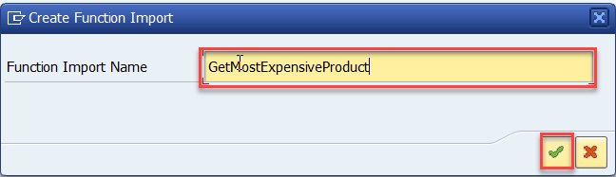
Function Import
At times, we need to implement the logic inside of OData which is not a direct CRUD operation e.g. calling a workflow, calling a BAPI which does some processing, Sending request to another server and can be invoked by the HTTP methods GET or POST .
For example: we can create the function import to GetMostExpensiveProduct in our Product set by the Category.
Step1: Right click the Data Model folder, and select Create and then select Function Import. Create Function Import dialog opens
Introduction
01
02
Trainer: Anubhav Oberoy & Shubham Singh

Slide 22
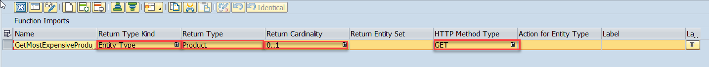
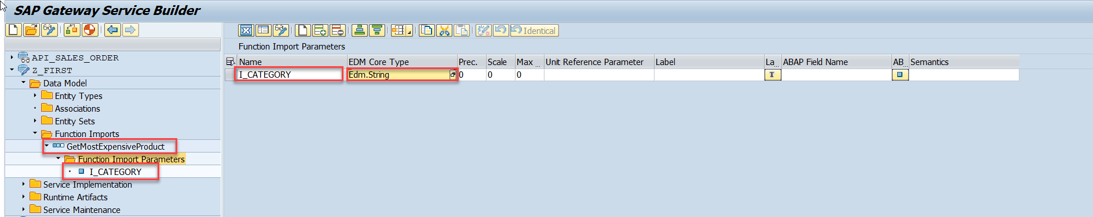
Steps for Creating Function Import
Step2: Enter return type kind, return type, return cardinality & HTTP method Type
Introduction
Step3: Giving function import parameters (I_CATEGORY)
01
Software Innovation
02
Trainer: Anubhav Oberoy & Shubham Singh

Slide 23
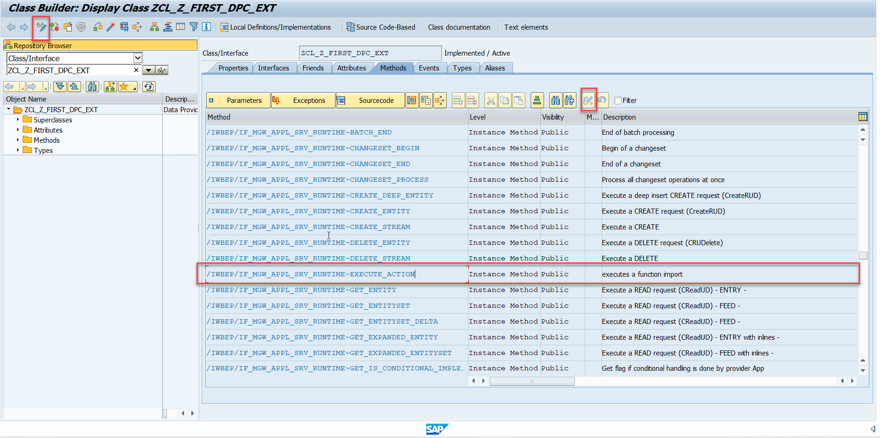
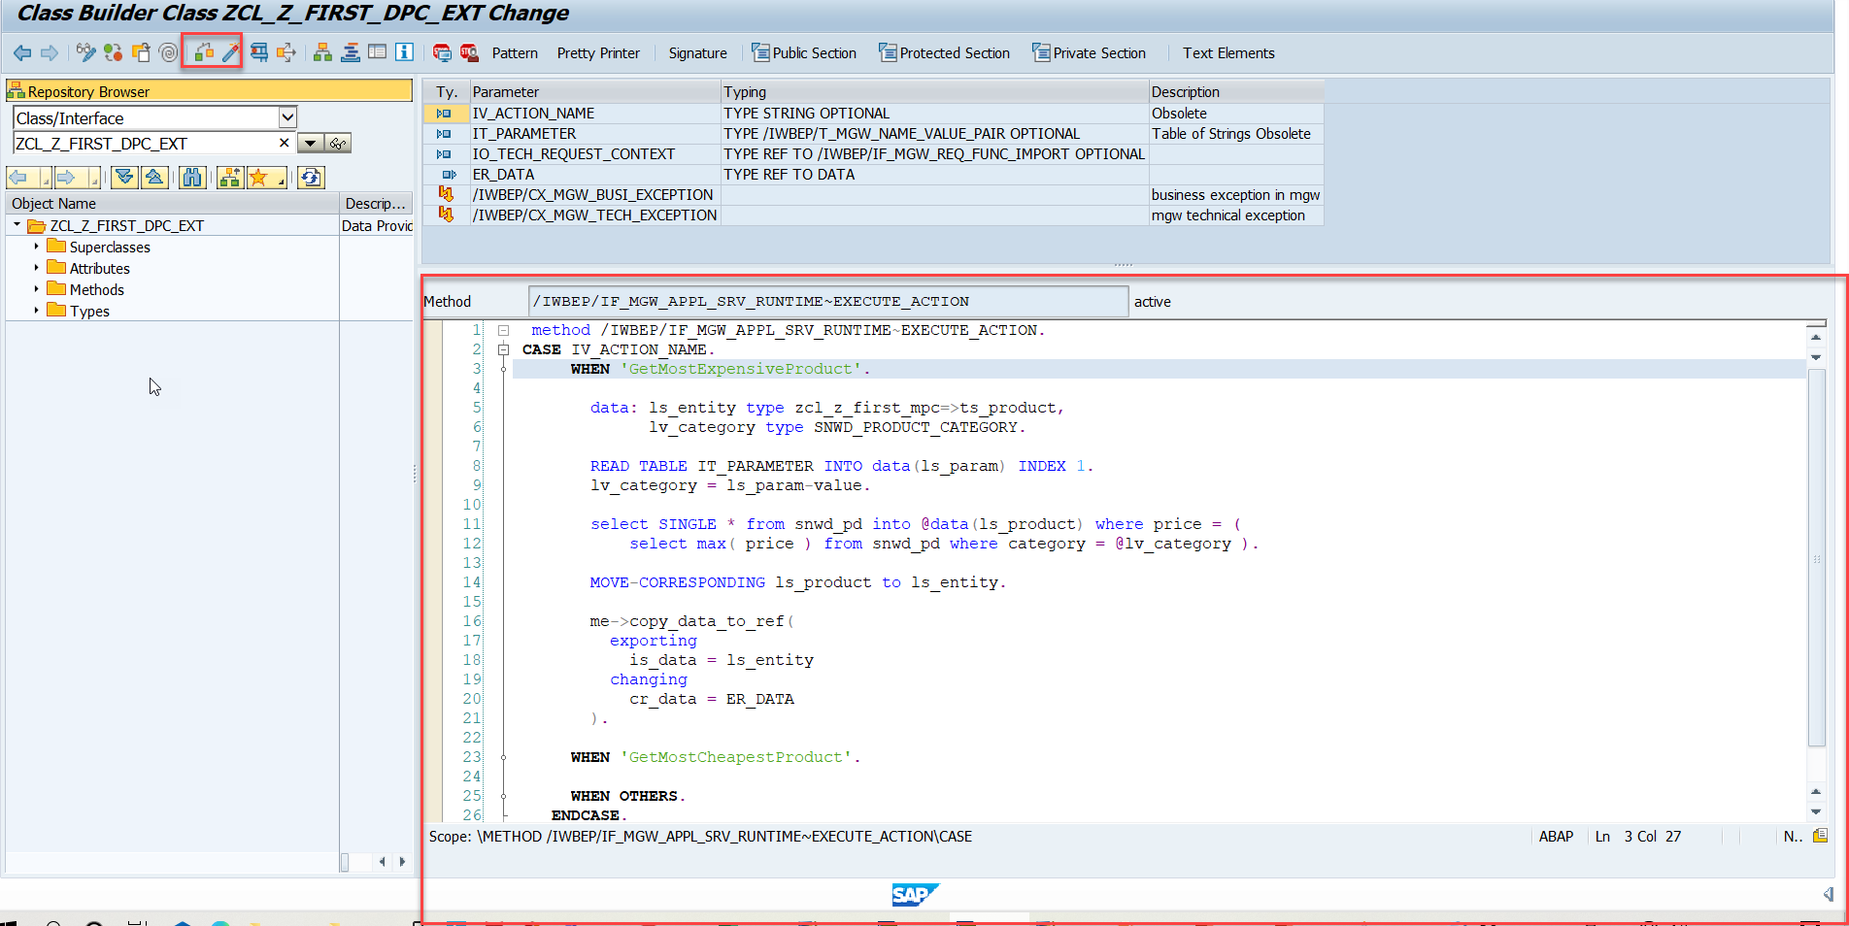
Steps for Creating Function Import
Step4: Go to DPC Extension and search for the method--/IWBEP/IF_MGW_APPL_SRV_RUNTIME~EXECUTE_ACTION and redefine the class method
Introduction
01
Software Innovation
02
Note: Click on the image to get Complete code.
Trainer: Anubhav Oberoy & Shubham Singh

Slide 24

Summarize
End of Day 5

Slide 25

Questions

Slide 26

ANUBHAV OBEROY
www.anubhavtrainings.com
THANK YOU
“You can never leave footprints that last if you are always walking on tiptoe.”
Notes:
https://pixabay.com/photos/men-employees-suit-work-greeting-1979261/

Slide 27


We’re committed to empower you to be
Most Desirable Resource
through powerful training solutions.
We build the workforce of the future.
250+
Corporate Clients
30,000+
Learners Trained
25000+
Learners Placed
FREE WEBINARS
Sign up for free webinars with industry experts every fortnight!
Enroll Now!
Contact us today!
https://anubhavtrainings.com/

Slide 28




More from AnubhavTrainings.com

